Slide 1
TensorFlow
Features in Images, Part 4
COMP 4230

Slide 2
ALERTS
Lab 2 due Friday
During Fall Break, Read Chapter 4 of Moroney and
Chapter 10 of Larson
  We will not spend class time on chapter 4, so read it carefully, play with the code samples and try using different features of TFDS
We will begin Chapter 5 of Moroney after break

Slide 3
Multiclass Classification
Building non-binary classifiers requires some slight modifications to the parameters and functions that are used by the model
Loss function: categorical_crossentropy
ImageDataGenerator: categorical
Output activation function: softmax
Input & output shapes, as appropriate

Slide 4
Dropout Regularization
Another strategy to mitigate against over-fitting
Similarly to Hebbian-learning (neurons that fire together, wire together) it turns out that neighboring neurons tend to develop similar weights. The downside to this is that if one neuron begins to over-fit, it may influence neighboring neurons to do the same.
By randomly dropping some neurons from each training iteration, it reduces this tendency and prevents overfitting.

Slide 5
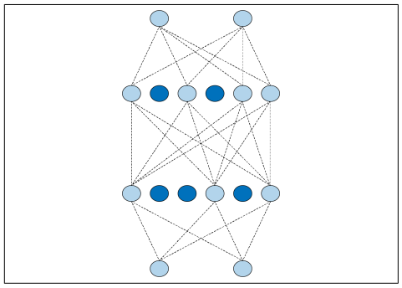
Dropout Regularization
Here is an example, where the dark blue nodes are temporarily suppressed from participating in the training

Slide 6
Dropout Regularization
model = tf.keras.models.Sequential([
tf.keras.layers.Flatten(input_shape=(28,28)),
tf.keras.layers.Dense(256, activation=tf.nn.relu),
tf.keras.layers.Dropout(0.2),
tf.keras.layers.Dense(128, activation=tf.nn.relu),
tf.keras.layers.Dropout(0.2),
tf.keras.layers.Dense(64, activation=tf.nn.relu),
tf.keras.layers.Dropout(0.2),
tf.keras.layers.Dense(10, activation=tf.nn.softmax)
])

Slide 7
Lab 3...

